Slide 1
Choosing the right journal for your manuscript
By
Assoc. Prof. Dr. Salih Mahdi Salman
Department of Biochemistry-Faculty of Medicine University of Diyala
Dec 27th 2015

Slide 2
Why Writing & publication
Requirement for graduation
Requirement for promotion
To get reward/award
To be recognized
To disseminate knowledge

Slide 3
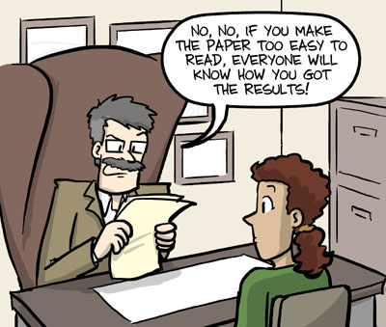
How to Write a Scientific Article
Title
Affiliation
Abstract
Keywords
1. Introduction
2. Materials and Methods
3. Results/Findings and Discussion
4.Conclusions
Acknowledgements
References
Author’s Biography/ some journals
AUTHOR’S BIOGRAPHY
Associate Professor Dr. Salih Mahdi Salman, obtained both bachelor’s and master’s degree of science in organic chemistry from the University of Baghdad and completed his Ph.D. at the University of Malaya under supervision of Associate Professor Thorsten Heidelberg and Hariul Anuar Tajuddin in 2013. Currently he is a lecturer at the department of chemistry, Faculty of Medicine, University of Diyala in Iraq. His interest area is organic synthesis.

Slide 4
When your manuscript be ready…There are three questions you should ask yourself while selecting a journal.
First, which journals count toward tenure or promotion?
Second, do I want to publish in a general or a focused journal?
Finally, which journals’ requirements does my manuscript meet

Slide 5
Where to Publish?
well known , highly valued by the authors , mentioned in conversation and at scientific presentations, and often be a built-in readership, such as the members of a sponsoring Society. readily recognized target audience, then the published material is likely to be seen, read, and acted on.
Indexed Journal
Level of difficulty
There’s no point in conducting research and then publishing it in a journal that doesn’t count. In fact, doing so may count against you because a committee may wonder why you are wasting time with an inferior journal.
Non Indexed Journal
Conference

Slide 6
But, choosing the indexed journal for a manuscript can be a big challenging.
Many factors are likely to influence the final decision.
It is important to have a set of criteria by which the merits of a journal can be assessed.
This maximizing the chance that the author’s expectations will be met.

Slide 7
If you already decided and chose to publish with an impact factor indexing journal.
Let we share experiences to shorten the way and find the right journal.

Slide 8
Journal
X Non- indexing journals
√ Indexed Journals
1. Scopus Indexed Journals
2. ISI Indexed Journals
Founded by Eugene Garfield in 1960. It was acquired by Thomson Scientific & Healthcare in 1992, and became known as Thomson ISI.

Slide 9
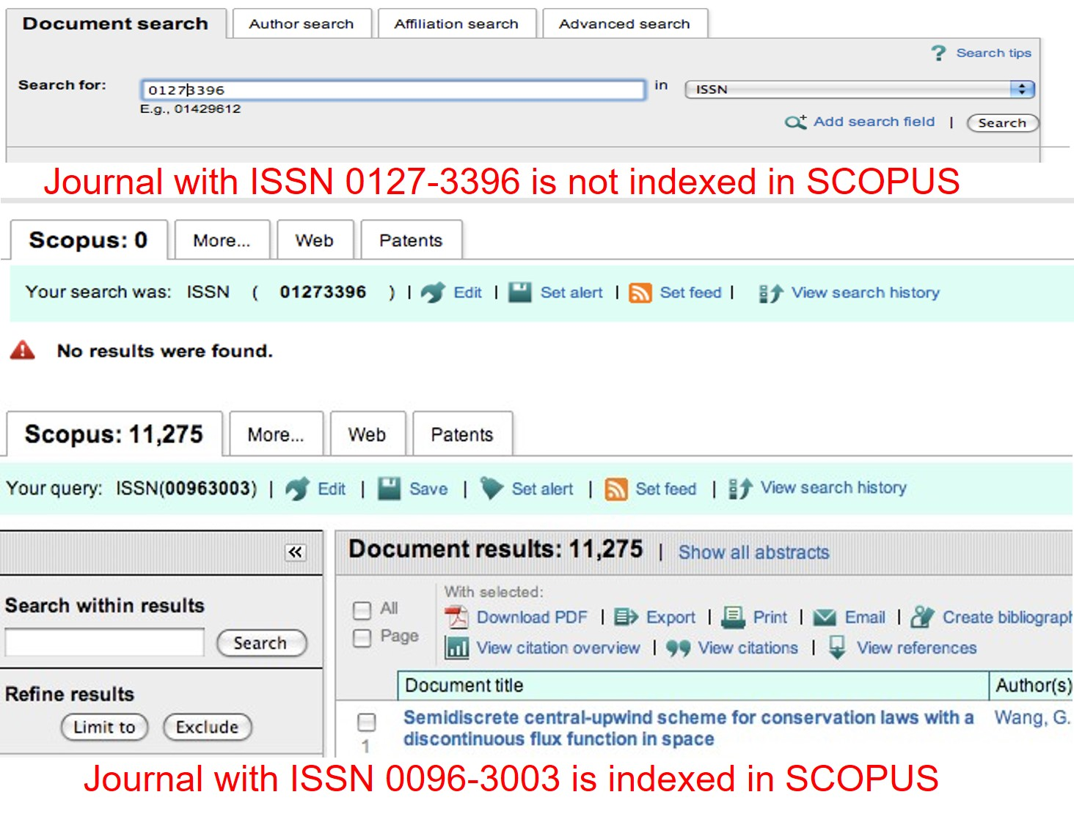
Scopus Indexed Journals
Need to connect with
university’s server
http://www.scopus.com
Key in journal’s ISSN
Select ISSN and search

Slide 10
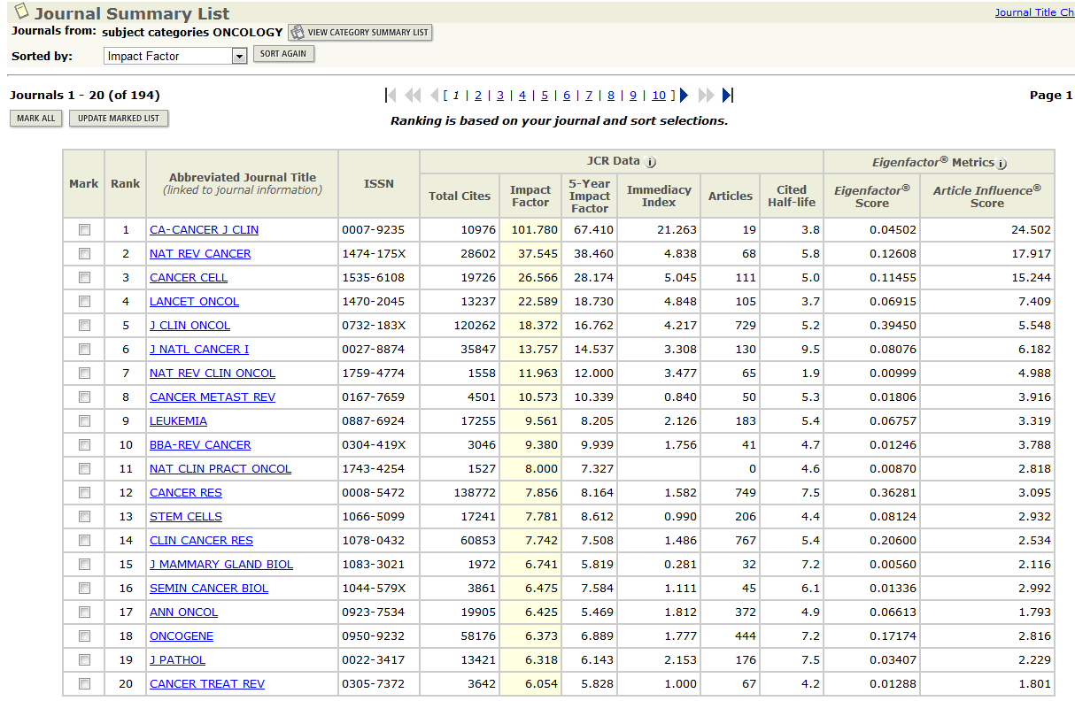
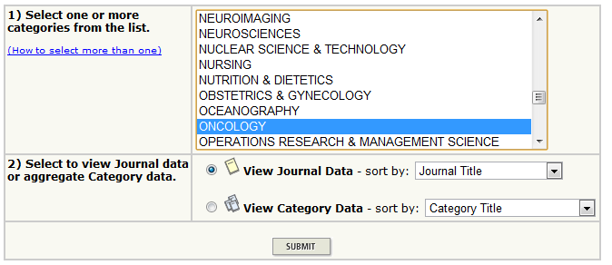
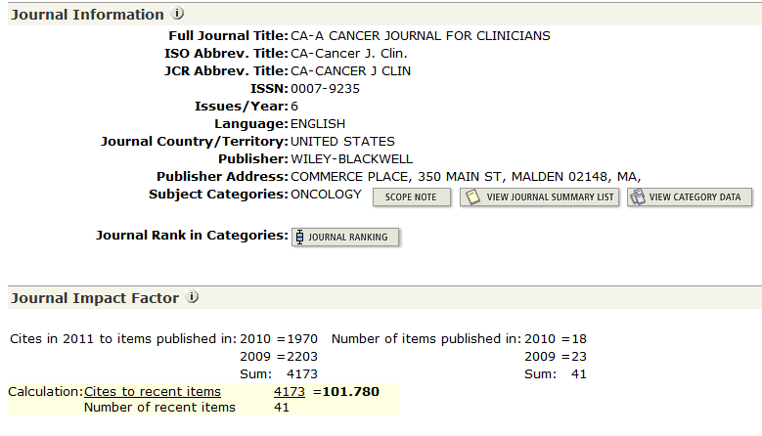
How to check ISI journal
Need to connect with
university’s server
http://www.isiknowledge.com
Click at “additional resources”
Click at “journal citation report”
Click

Slide 11
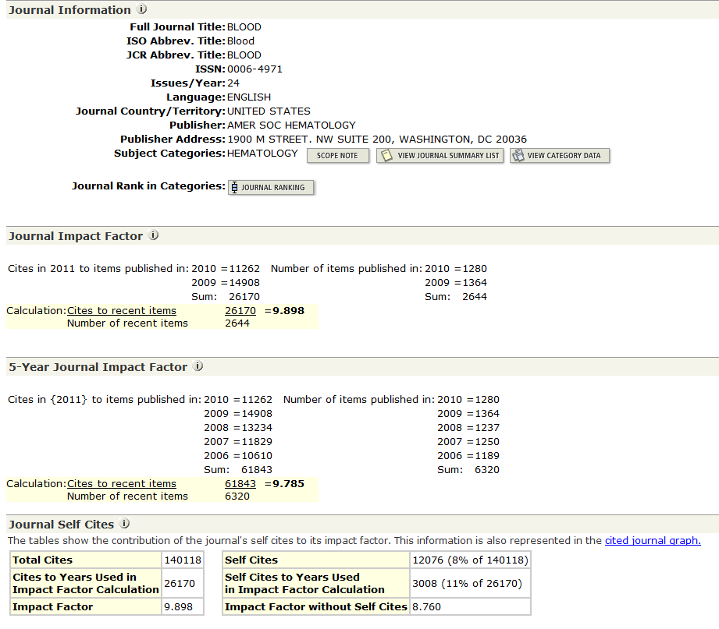
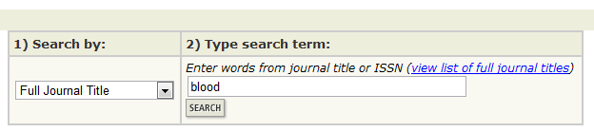
Click

Slide 12
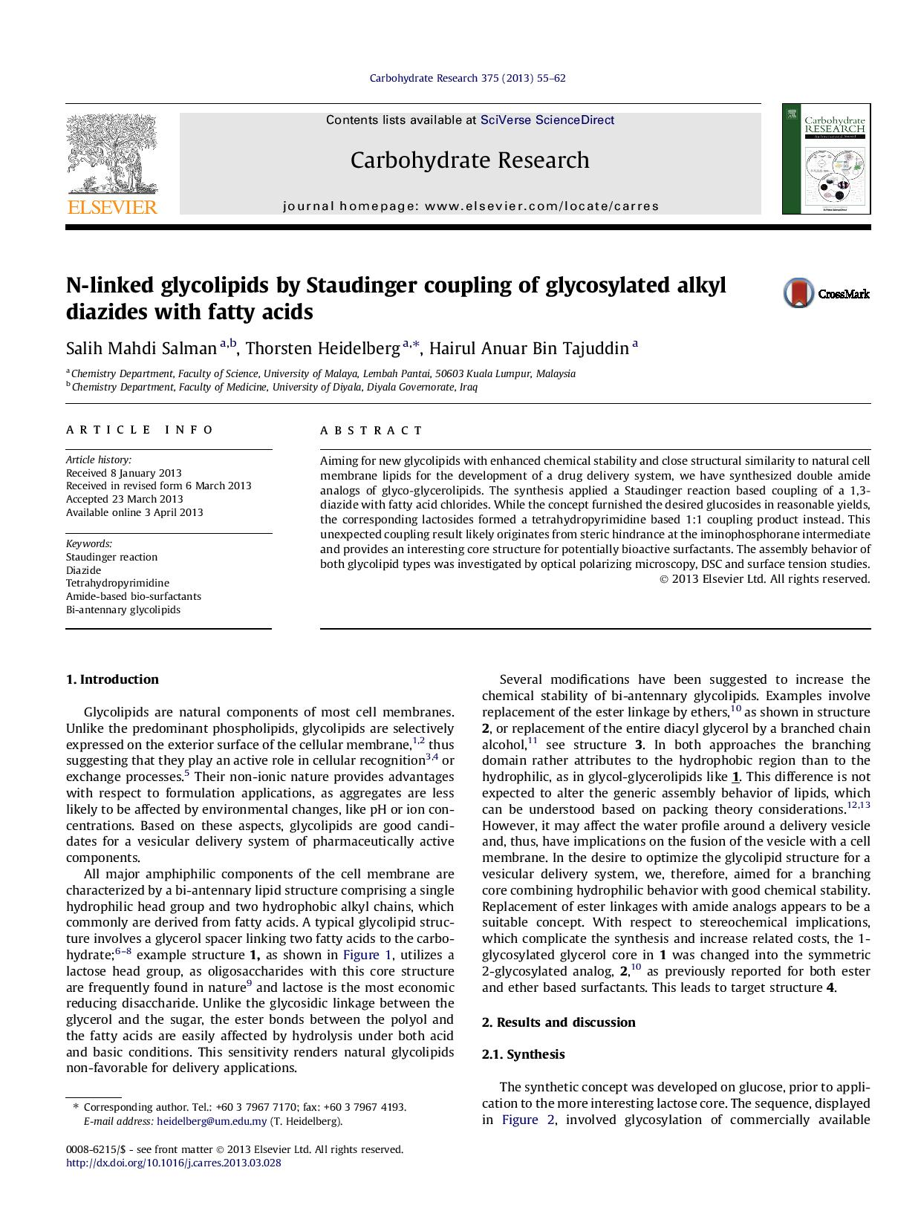
Look in Your Citation List
The first place to look for an appropriate journal to publish your article is in your own citation list. .
If you are citing several articles from a particular journal, that is a good sign that journal may be an appropriate place to submit your article.

Slide 13
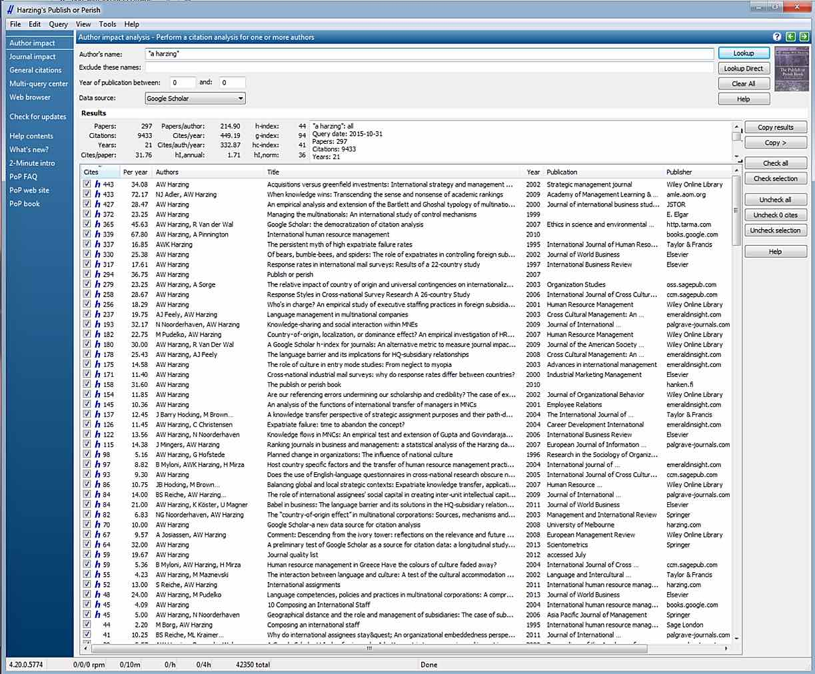
Using Special Software
You can use Publish or Perish software http://www.harzing.com/resources.htm#/pop.htm, to get data on the impact factor and citation rate of journals in your field.

Slide 15
Open access websites
Other website which have relation with THOMSON REUTER such as INTELLECTUAL PROPERTY & SCIENCE
http://ip-science.thomsonreuters.com/cgi-bin/jrnlst/jloptions.cgi?PC=master
Which offer full list of ISI journal with the basic information about those journal

Slide 16
http://ip-science.thomsonreuters.com/cgi-bin/jrnlst/jloptions.cgi?PC=master

Slide 17
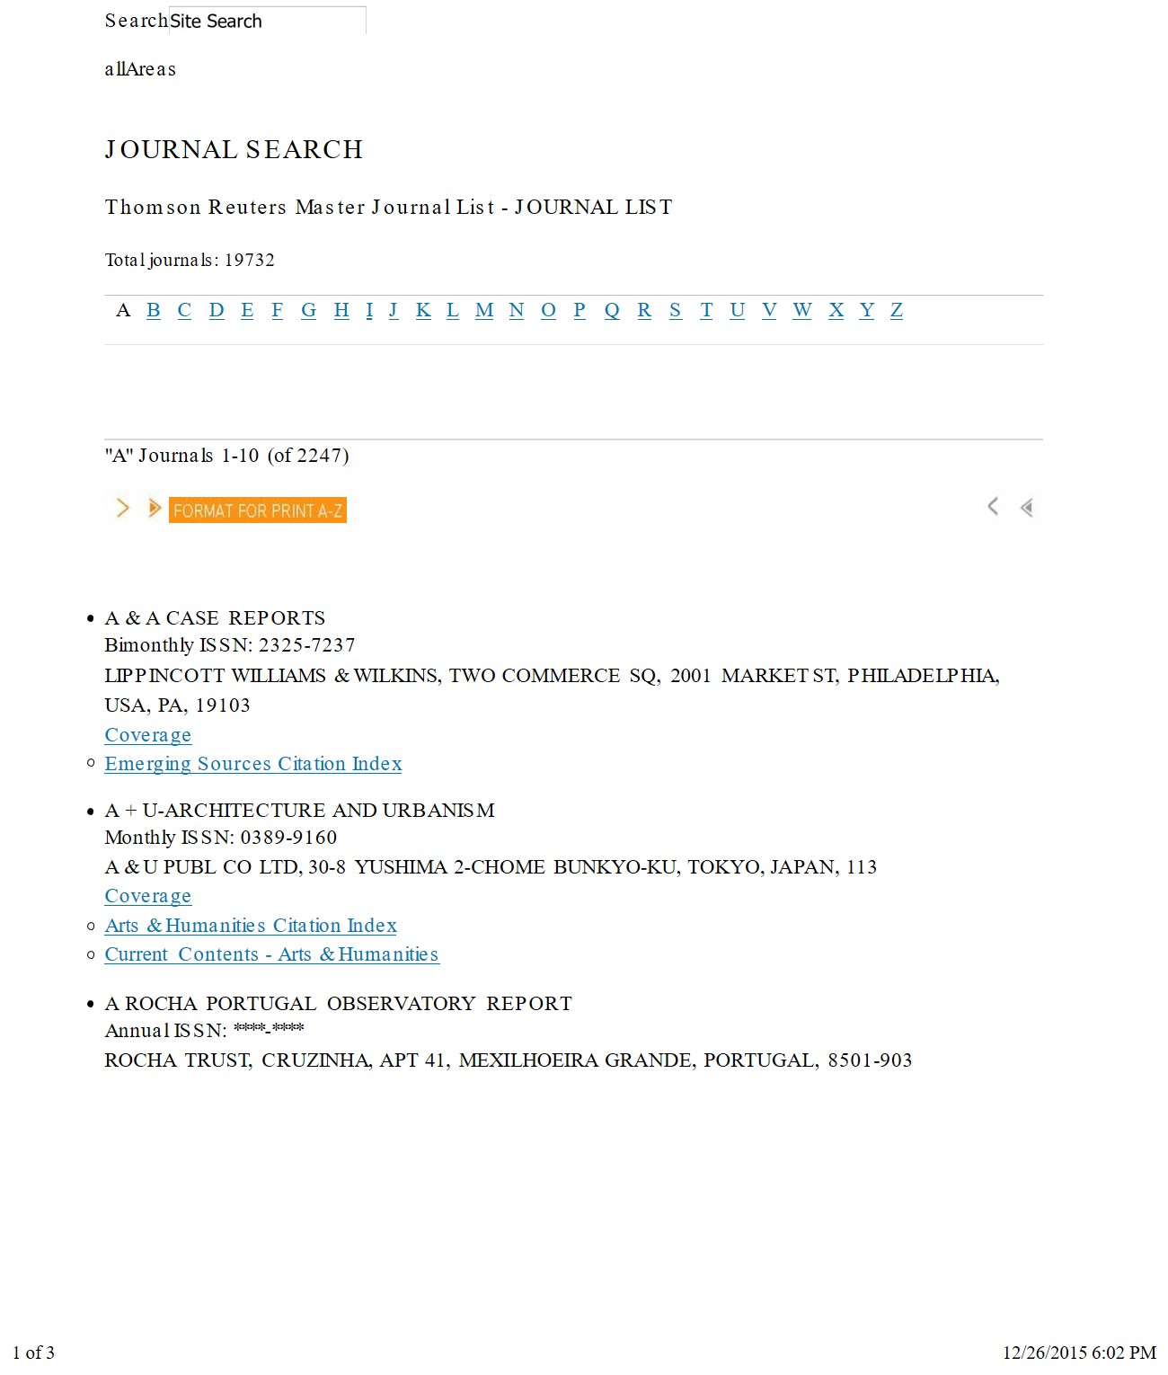
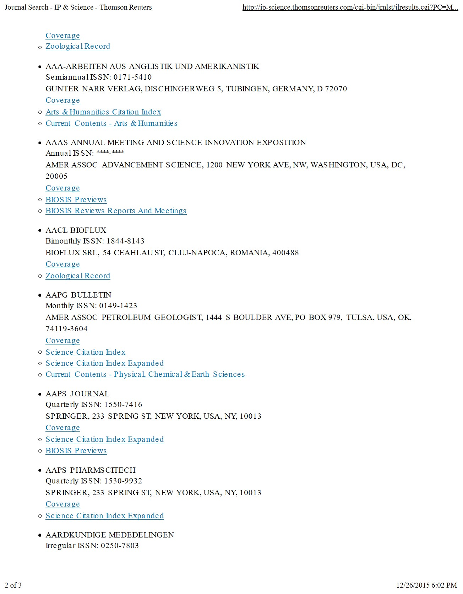

Slide 18
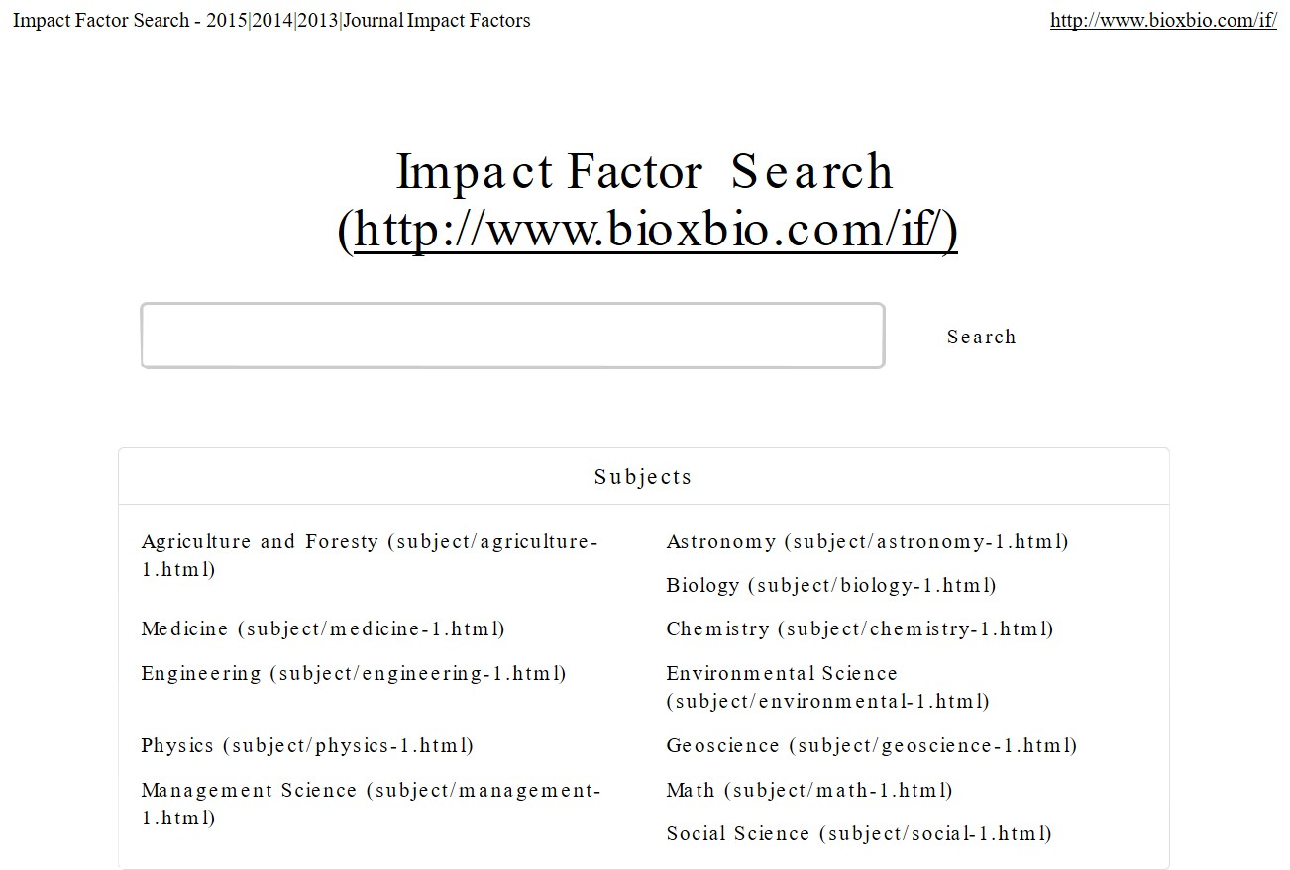
Online Impact Factor Search
Impact factors are calculated yearly by Thomson Reuters starting from 1975 for those journals that are indexed in the Journal Citation Reports. via Wikipedia

Slide 19
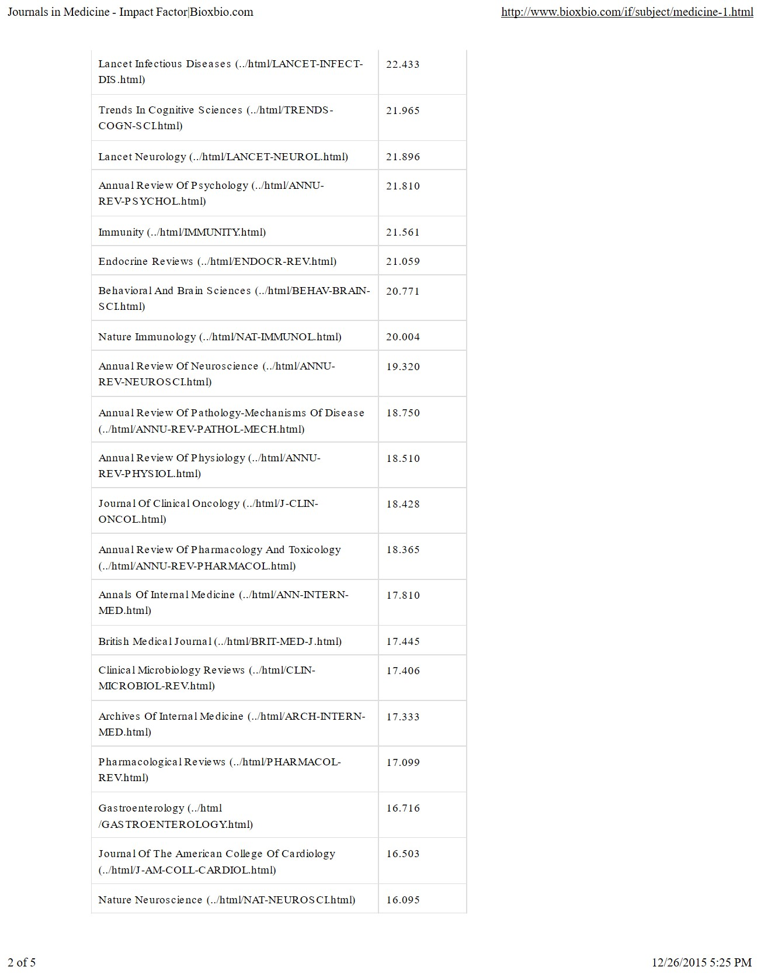

Slide 20
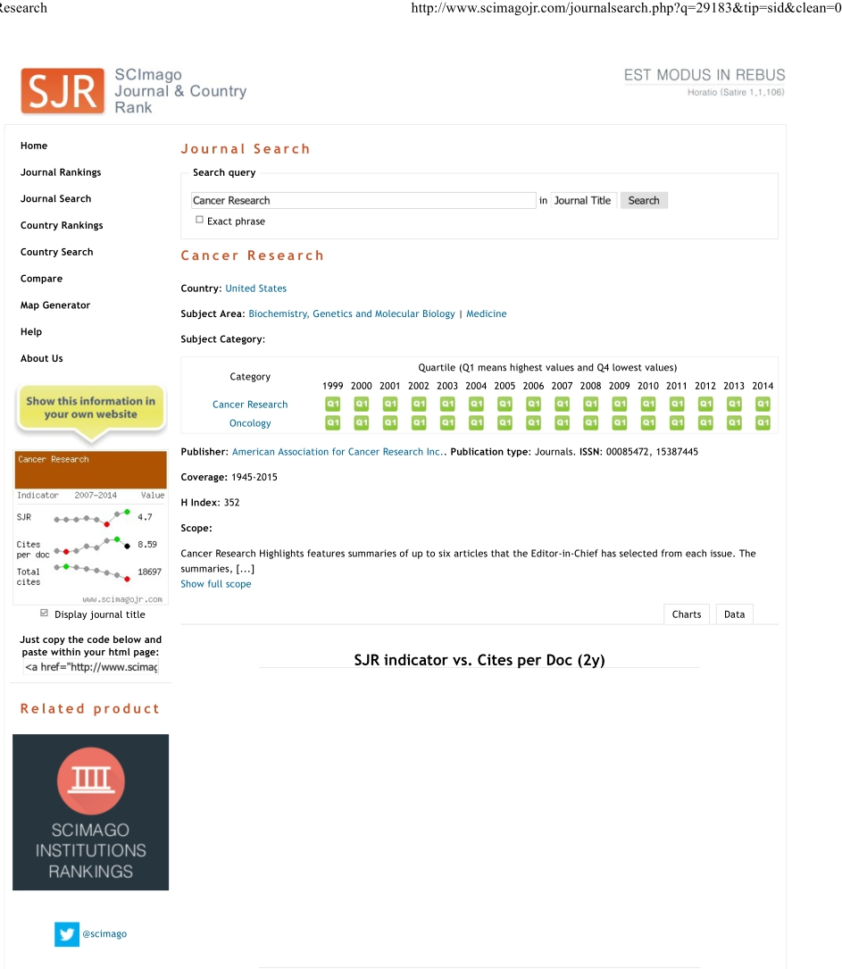
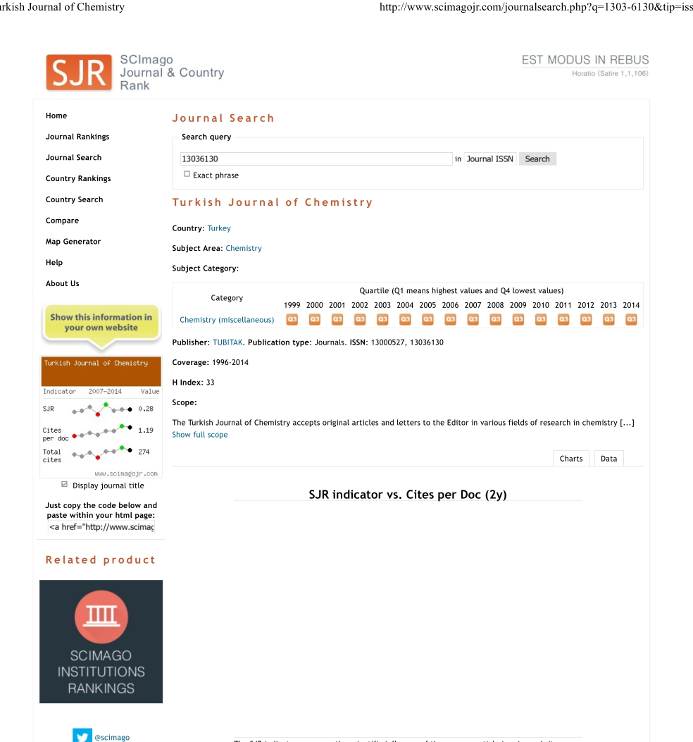
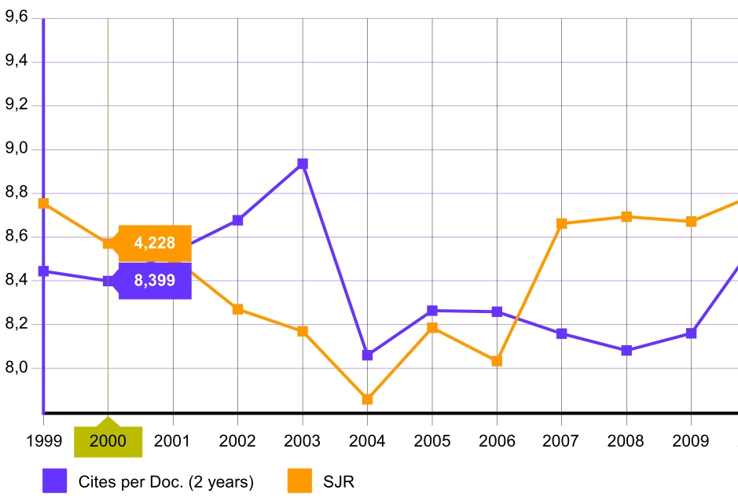
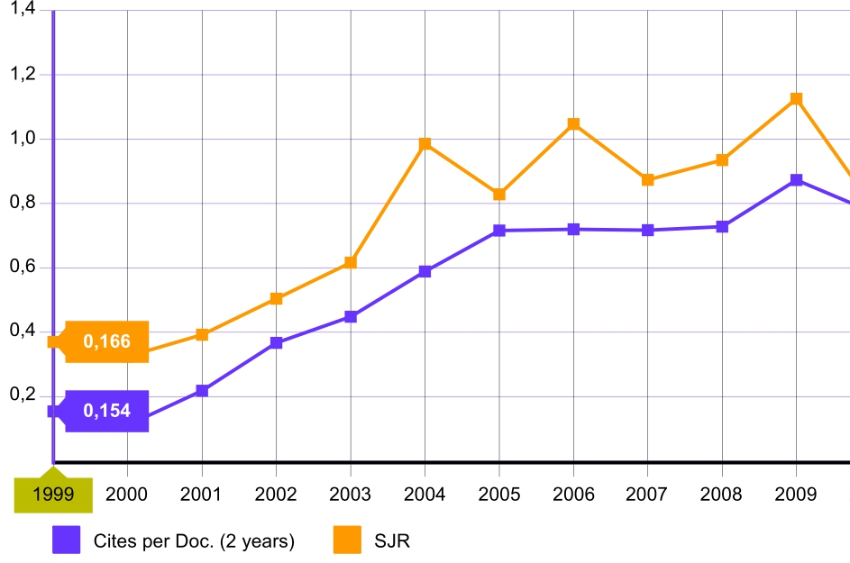
SCImago Journal & Country Rank (SJR )
http://www.scimagojr.com/journalsearch.php?q=Springer&tip=pub

Slide 21
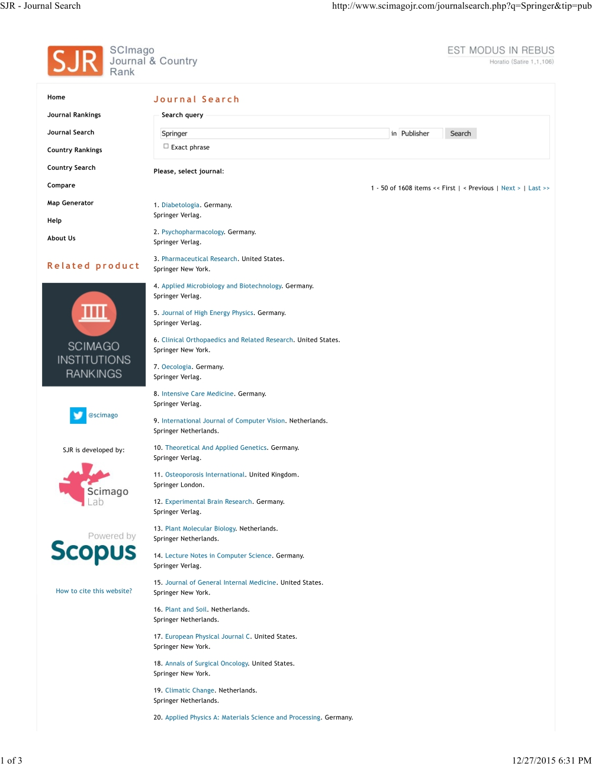
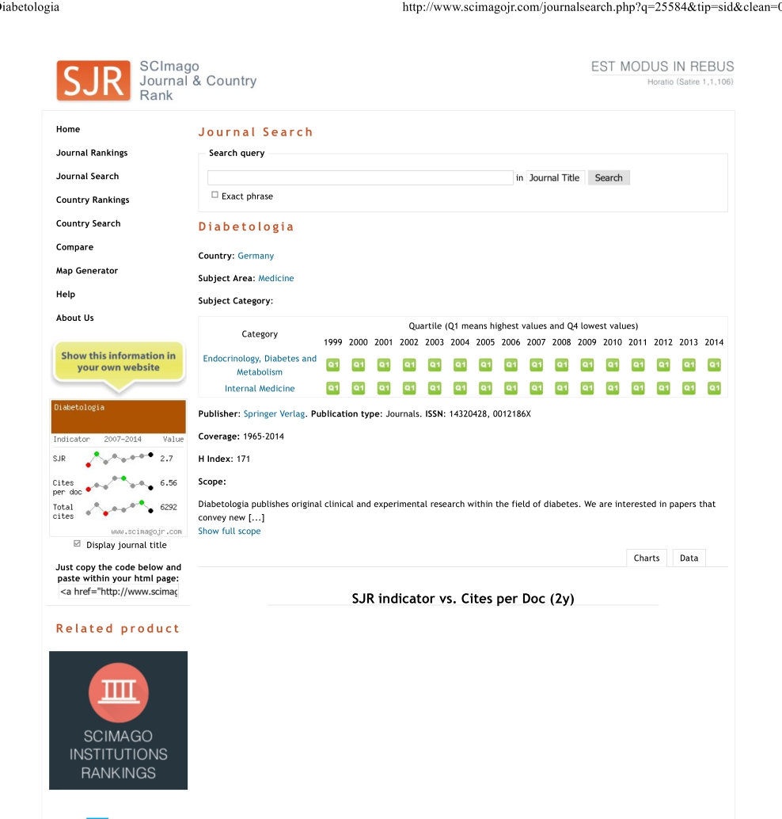
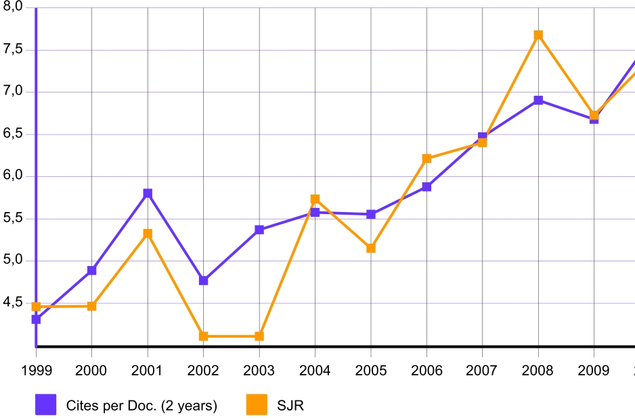

Slide 22
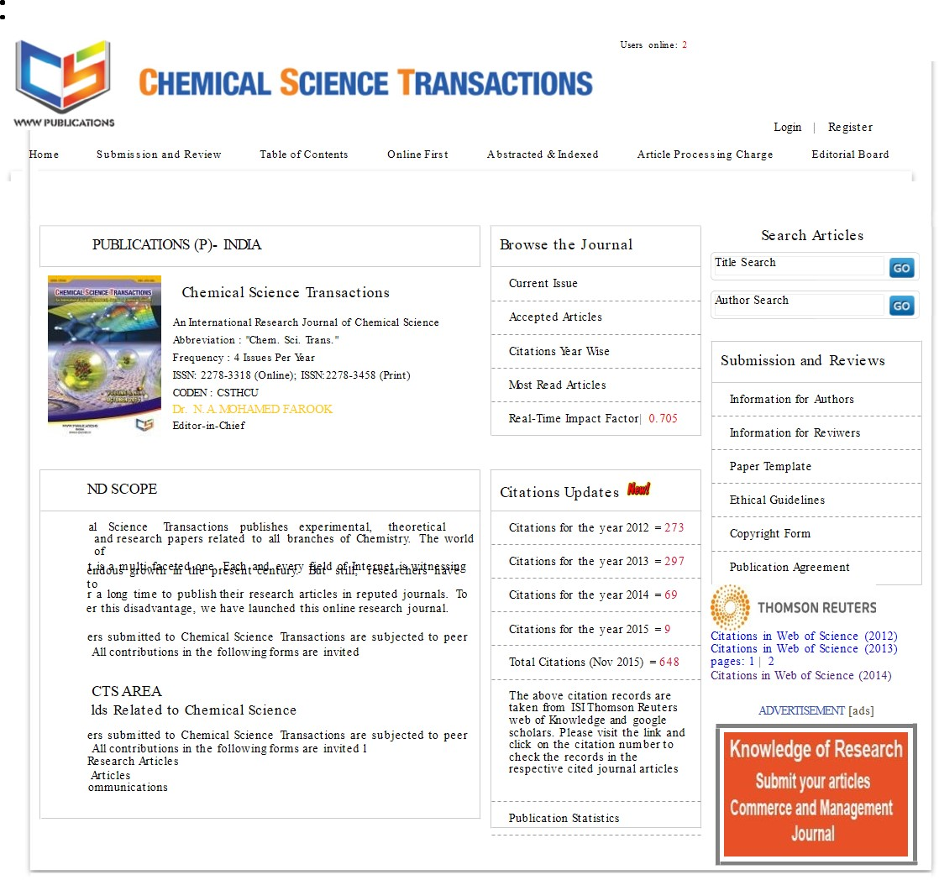
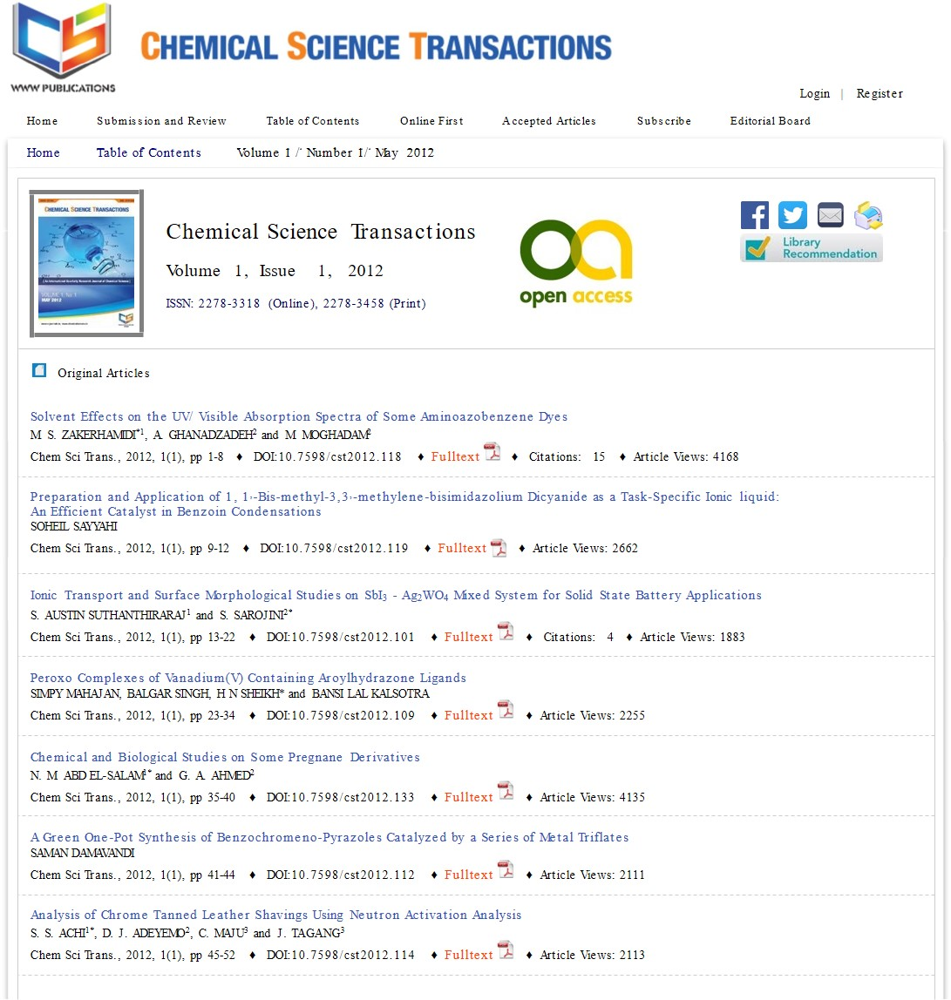
Others Impact Factor Journal , Which Calculate The Impact Factor Based on Citation

Slide 23
Before You Start Submitting Your Manuscript You Should
Register online with the target journal
Read the author guideline for the target journal carefully and arrange your manuscript according to this guideline .
Prepare Full name, the e-mail address and phone number of at least 4 referees.
Write a cover letter for your manuscript.
Download and fill the copyright form for the journal you wish to publish in it.
Do an Author’s Biography
Then start submission

Slide 24
Thank you for your attention

